Slide 1
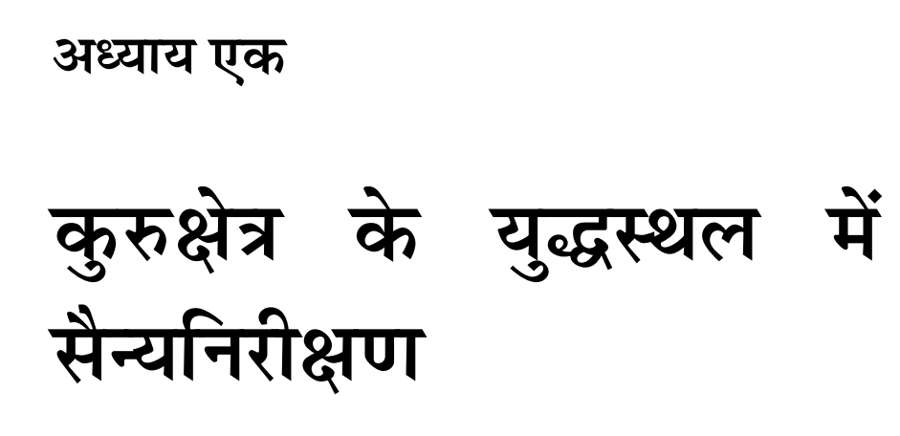

Slide 2











Slide 3











Slide 4











Slide 5
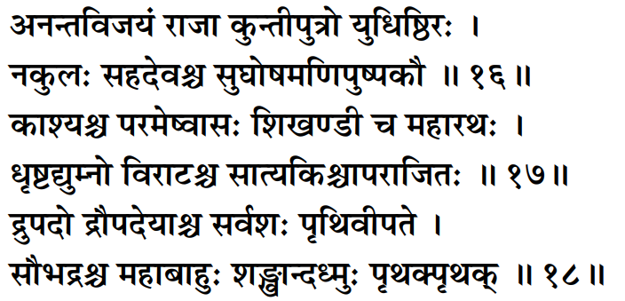







Slide 8
Another Book
Only Hindi

